Slide 1
Flow of Control
Chapter 3
Edited by JJ Shepherd

Slide 2
Objectives
Use Java branching statements
Compare values of primitive types
Compare objects such as strings
Use the primitive type boolean
Use simple enumerations in a program

Slide 3
Outline
The if-else Stetement
The Type boolean
The switch statement
(optional) Graphics Supplement

Slide 4
Flow of Control
Flow of control is the order in which a program performs actions.
  Up to this point, the order has been sequential.
A branching statement chooses between two or more possible actions.
A loop statement repeats an action until a stopping condition occurs. We’ll get to this in the next chapter.

Slide 5
IF- ELSE!

Slide 6
The if-else Statement: Outline
Basic if-else Statement
Boolean Expressions
Comparing Strings
Nested if-else Statements
Multibranch if-else Statements
The switch Statament
(optional) The Conditional Operator
The exit Method

Slide 7
The if-else Statement
A branching statement that chooses between two possible actions.
Syntax
  if (Boolean_Expression)
  Statement_1
  else
  Statement_2
  I’m not the biggest fan of this style of coding. It only works if there is only ONE statement

Slide 8
The if-else Statement
I like this better, since you can put multiple statements in betwixt the curly braces
Syntax
  if (Boolean_Expression)
  {
  Statement_1
  }
  else
  {
  Statement_2
  }

Slide 9
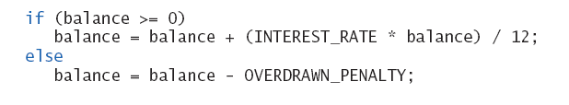
The if-else Statement
Example

Slide 10
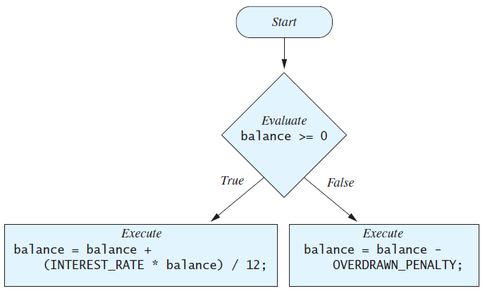
The if-else Statement
Figure 3.1 The Action of the if-else Statement sample program Listing 3.1

Slide 11
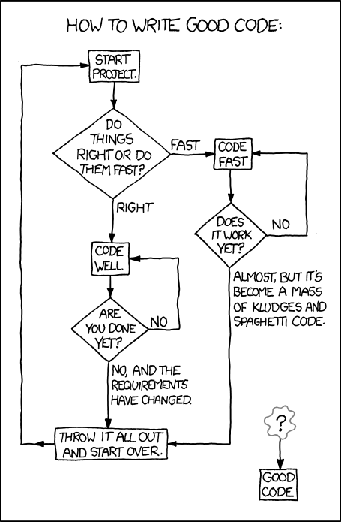
Flow Charts
Square are statements
Diamond are decisions
It is a good idea to draw these before coding
May have to draw these on an exam…

Slide 12
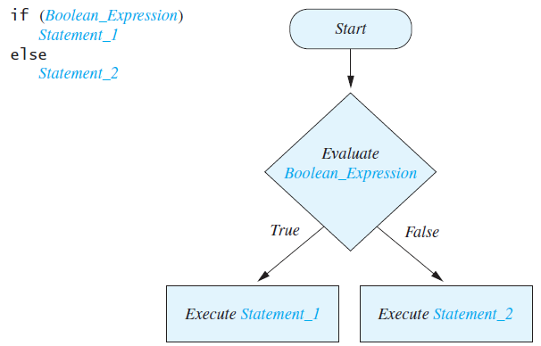
Semantics of the if-else Statement
Figure 3.2

Slide 13
Compound Statements
To include multiple statements in a branch, enclose the statements in braces.
  if (count < 3)
  {
  total = 0;
  count = 0;
  }

Slide 14
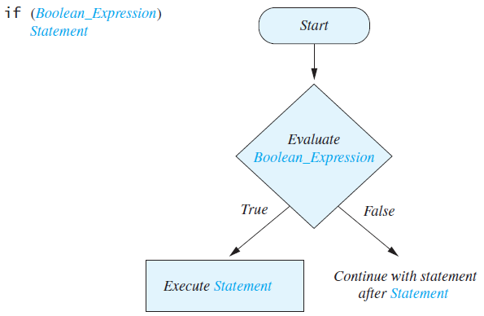
Omitting the else Part
FIGURE 3.3 The Semantics of an if Statement without an else
if statements do not need an else, but an else needs an if

Slide 15
Example!
Notes:
PantsTest.java

Slide 16
Example Explained
  System.out.println(“Are you wearing pants? True or False”);
  Scanner keyboard = new Scanner(System.in);
  boolean wearingPants = keyboard.nextBoolean();
  if (wearingPants == true)
  {
  System.out.println(“Nice Pants!”);
  }
  else
  {
  System.out.println(“You are under arrest”);
  }

Slide 17
Example Explained
  System.out.println(“Are you wearing pants? True or False”);
  Scanner keyboard = new Scanner(System.in);
  boolean wearingPants = keyboard.nextBoolean();
  if (wearingPants == true)
  {
  System.out.println(“Nice Pants!”);
  }
  else
  {
  System.out.println(“You are under arrest”);
  }

Slide 18
Example Explained
  System.out.println(“Are you wearing pants? True or False”);
  Scanner keyboard = new Scanner(System.in);
  boolean wearingPants = keyboard.nextBoolean();
  if (wearingPants == true)
  {
  System.out.println(“Nice Pants!”);
  }
  else
  {
  System.out.println(“You are under arrest”);
  }

Slide 19
Example Explained
  System.out.println(“Are you wearing pants? True or False”);
  Scanner keyboard = new Scanner(System.in);
  boolean wearingPants = keyboard.nextBoolean();
  if (wearingPants == true)
  {
  System.out.println(“Nice Pants!”);
  }
  else
  {
  System.out.println(“You are under arrest”);
  }
ASSUMING THE USER INPUTTED TRUE

Slide 20
Example Explained
  System.out.println(“Are you wearing pants? True or False”);
  Scanner keyboard = new Scanner(System.in);
  boolean wearingPants = keyboard.nextBoolean();
  if (wearingPants == true)
  {
  System.out.println(“Nice Pants!”);
  }
  else
  {
  System.out.println(“You are under arrest”);
  }
ASSUMING THE USER INPUTTED TRUE

Slide 21
Example Explained
  System.out.println(“Are you wearing pants? True or False”);
  Scanner keyboard = new Scanner(System.in);
  boolean wearingPants = keyboard.nextBoolean();
  if (wearingPants == true)
  {
  System.out.println(“Nice Pants!”);
  }
  else
  {
  System.out.println(“You are under arrest”);
  }
ASSUMING THE USER INPUTTED TRUE

Slide 22
Alternatively!

Slide 23
Example Explained
  System.out.println(“Are you wearing pants? True or False”);
  Scanner keyboard = new Scanner(System.in);
  boolean wearingPants = keyboard.nextBoolean();
  if (wearingPants == true)
  {
  System.out.println(“Nice Pants!”);
  }
  else
  {
  System.out.println(“You are under arrest”);
  }
ASSUMING THE USER INPUTTED FALSE

Slide 24
Example Explained
  System.out.println(“Are you wearing pants? True or False”);
  Scanner keyboard = new Scanner(System.in);
  boolean wearingPants = keyboard.nextBoolean();
  if (wearingPants == true)
  {
  System.out.println(“Nice Pants!”);
  }
  else
  {
  System.out.println(“You are under arrest”);
  }
ASSUMING THE USER INPUTTED FALSE

Slide 25
Example Explained
  System.out.println(“Are you wearing pants? True or False”);
  Scanner keyboard = new Scanner(System.in);
  boolean wearingPants = keyboard.nextBoolean();
  if (wearingPants == true)
  {
  System.out.println(“Nice Pants!”);
  }
  else
  {
  System.out.println(“You are under arrest”);
  }
ASSUMING THE USER INPUTTED FALSE

Slide 26
Boolean Expressions!

Slide 27
Introduction to Boolean Expressions
The value of a boolean expression is either true or false.
Examples
  time < limit
  balance <= 0

Slide 28
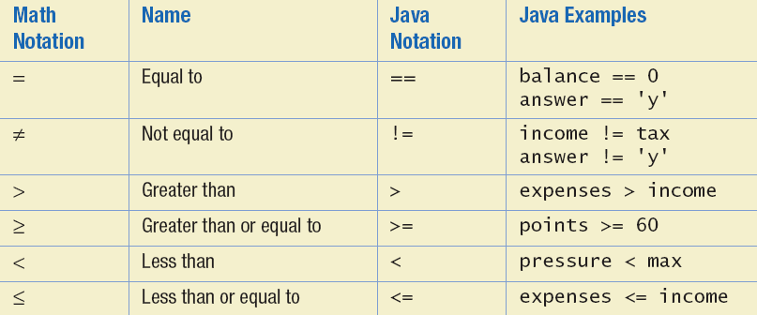
Java Comparison Operators
Figure 3.4 Java Comparison Operators

Slide 29
Compound Boolean Expressions
Boolean expressions can be combined using the "and" (&&) operator.
Example
  if ((score > 0) && (score <= 100))
  ...
Not allowed
  if (0 < score <= 100)
  ...

Slide 30
Compound Boolean Expressions
Syntax
  (Sub_Expression_1) && (Sub_Expression_2)
Parentheses often are used to enhance readability.
The larger expression is true only when both of the smaller expressions are true.

Slide 31
Compound Boolean Expressions
Boolean expressions can be combined using the "or" (||) operator.
Example
  if ((quantity > 5) || (cost < 10))
  ...
Syntax
  (Sub_Expression_1) || (Sub_Expression_2)

Slide 32
Compound Boolean Expressions
The larger expression is true
  When either of the smaller expressions is true
  When both of the smaller expressions are true.
The Java version of "or" is the inclusive or which allows either or both to be true.
The exclusive or allows one or the other, but not both to be true.

Slide 33
Negating a Boolean Expression
A boolean expression can be negated using the "not" (!) operator.
Syntax
  !(Boolean_Expression)
Example
  (a || b) && !(a && b)
  which is the exclusive or

Slide 34
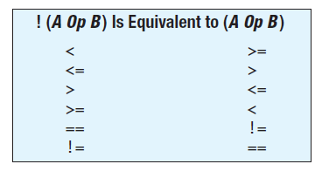
Negating a Boolean Expression
Figure 3.5 Avoiding the Negation Operator

Slide 35
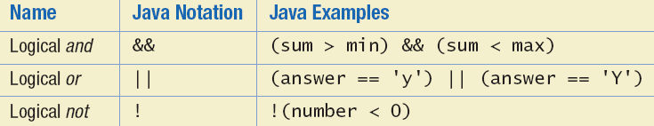
Java Logical Operators
Figure 3.6

Slide 36
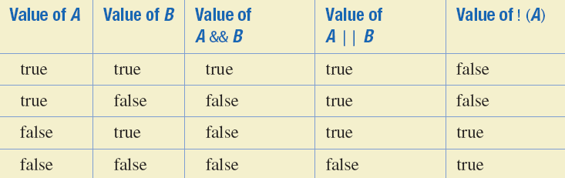
Boolean Operators
FIGURE 3.7 The Effect of the Boolean Operators && (and), || (or), and ! (not) on Boolean values
For AND both values have to be TRUE for it to be TRUE
For OR only ONE value has to be TRUE for it to be TRUE

Slide 37
Using ==
== is appropriate for determining if two integers or characters have the same value.
  if (a == 3)
  where a is an integer type
== is NOT appropriate for determining if two floating points values are equal. Use < and some appropriate tolerance instead.
  if (abs(b - c) < epsilon)
  where b, c, and epsilon are floating point types

Slide 38
Using ==
== is NOT appropriate for determining if two objects have the same value.
  if (s1 == s2), where s1 and s2 refer to strings, determines only if s1 and s2 refer the a common memory location.
  If s1 and s2 refer to strings with identical sequences of characters, but stored in different memory locations, (s1 == s2) is false.

Slide 39
Using ==
To test the equality of objects of class String, use method equals.
  s1.equals(s2)
  or
  s2.equals(s1)
To test for equality ignoring case, use method equalsIgnoreCase.
  ("Hello".equalsIgnoreCase("hello"))

Slide 40
equals and equalsIgnoreCase
Syntax
  String.equals(Other_String)
  String.equalsIgnoreCase(Other_String)

Slide 41
Lexicographic Order
Lexicographic order is similar to alphabetical order, but is it based on the order of the characters in the ASCII (and Unicode) character set.
  All the digits come before all the letters.
  All the uppercase letters come before all the lower case letters.

Slide 42
Lexicographic Order
Strings consisting of alphabetical characters can be compared using method compareTo and method toUpperCase or method toLowerCase.
  String s1 = "Hello";
  String lowerS1 = s1.toLowerCase();
  String s2 = "hello";
  if (s1.compareTo(s2)) == 0
  System.out.println("Equal!");

Slide 43
Method compareTo
Syntax
  String_1.compareTo(String_2)
Method compareTo returns
  a negative number if String_1 precedes String_2
  zero if the two strings are equal
  a positive number of String_2 precedes String_1.

Slide 44
Example!
Notes:
PantsTestStrings.java

Slide 45
Assignment Operator vs. Comparative Operator
The assignment operator is used to assign values to a variable
=
The comparative operator equals is used to determine if one value is equal to another value
==

Slide 46



